Slide 1

Department of Computer and Information Science,
School of Science, IUPUI
CSCI 230
Characters and Strings
Functions
Dale Roberts, Lecturer
Computer Science, IUPUI
E-mail: droberts@cs.iupui.edu

Slide 2


Character Handling Library
Character handling library
  Includes functions to perform useful tests and manipulations of character data
  Each function receives a character (an int) or EOF as an argument
The following slide contains a table of all the functions in <ctype.h>

Slide 3
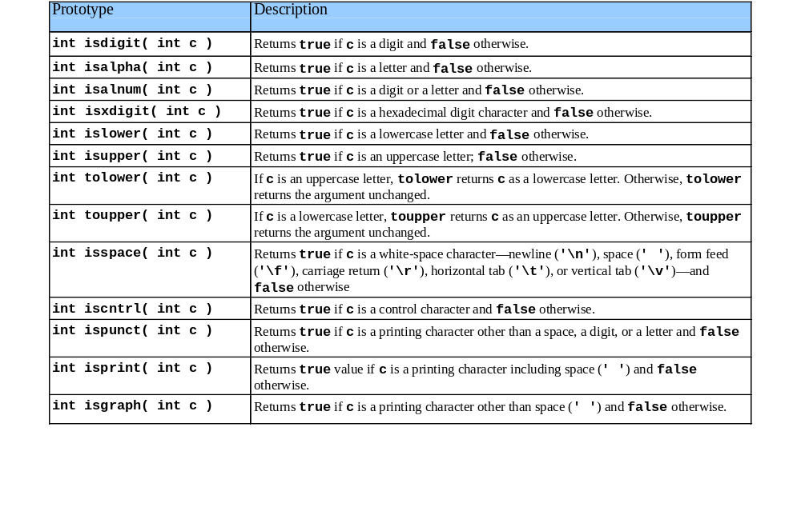
Character Handling Library

Slide 4
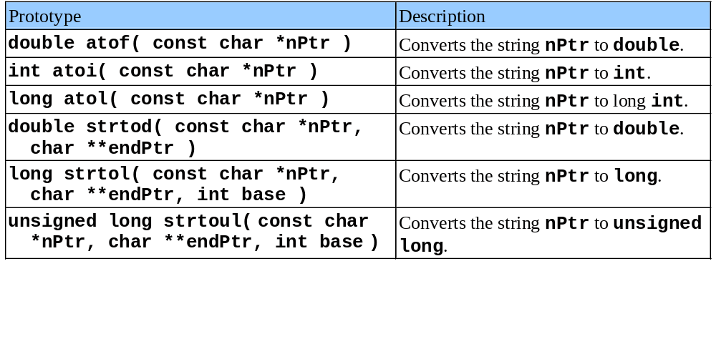
String Conversion Functions
Conversion functions
  In <stdlib.h> (general utilities library)
Convert strings of digits to integer and floating-point values

Slide 5
1 /* Fig. 8.6: fig08_06.c
1. Initialize variable
2. Convert string and
assign to variable
3. Print
Program Output
2 Using atof */
3 #include <stdio.h>
4 #include <stdlib.h>
5
6 int main()
7 {
8 double d;
9
10 d = atof( "99.0" );
11 printf( "%s%.3f\n%s%.3f\n",
12 "The string \"99.0\" converted to double is ", d,
13 "The converted value divided by 2 is ",
14 d / 2.0 );
15 return 0;
16 }
The string "99.0" converted to double is 99.000
The converted value divided by 2 is 49.500

Slide 6
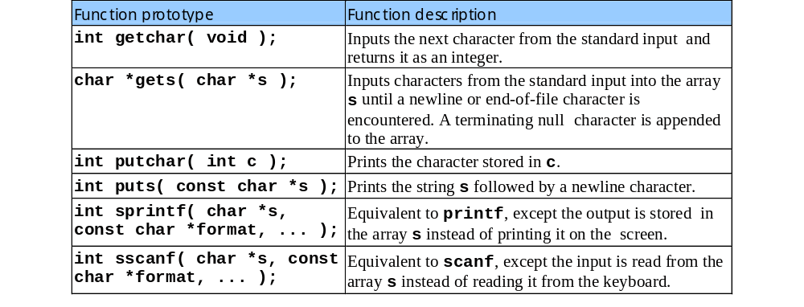
Standard Input/Output Library Functions
Functions in <stdio.h>
  Used to manipulate character and string data

Slide 7
1 /* Fig. 8.13: fig08_13.c
2 Using gets and putchar */
3 #include <stdio.h>
4
5 int main()
1. Initialize variables
2. Input
3. Print
3.1 Function definition (note recursion)
Program Output
6 {
7 char sentence[ 80 ];
8 void reverse( const char * const );
9
10 printf( "Enter a line of text:\n" );
11 gets( sentence );
12
13 printf( "\nThe line printed backwards is:\n" );
14 reverse( sentence );
15
16 return 0;
17 }
18
19 void reverse( const char * const sPtr )
20 {
21 if ( sPtr[ 0 ] == '\0' )
22 return;
reverse calls itself using substrings of the original string. When it reaches the '\0' character it prints using putchar
23 else {
24 reverse( &sPtr[ 1 ] );
25 putchar( sPtr[ 0 ] );
26 }
27 }
Enter a line of text:
Characters and Strings
The line printed backwards is:
sgnirtS dna sretcarahC

Slide 8
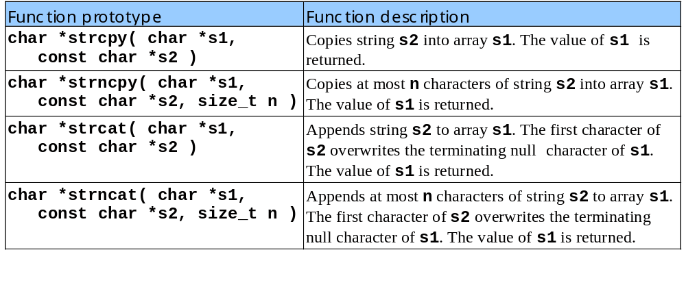
String Manipulation Functions
String handling library has functions to
  Manipulate string data
  Search strings
  Tokenize strings
  Determine string length

Slide 9
1 /* Fig. 8.19: fig08_19.c
2 Using strcat and strncat */
1. Initialize variables
2. Function calls
3. Print
Program Output
3 #include <stdio.h>
4 #include <string.h>
5
6 int main()
7 {
8 char s1[ 20 ] = "Happy ";
9 char s2[] = "New Year ";
10 char s3[ 40 ] = "";
11
12 printf( "s1 = %s\ns2 = %s\n", s1, s2 );
13 printf( "strcat( s1, s2 ) = %s\n", strcat( s1, s2 ) );
14 printf( "strncat( s3, s1, 6 ) = %s\n", strncat( s3, s1, 6 ) );
15 printf( "strcat( s3, s1 ) = %s\n", strcat( s3, s1 ) );
16 return 0;
17 }
s1 = Happy
s2 = New Year
strcat( s1, s2 ) = Happy New Year
strncat( s3, s1, 6 ) = Happy
strcat( s3, s1 ) = Happy Happy New Year

Slide 10
Comparison Functions
Comparing strings
  Computer compares numeric ASCII codes of characters in string
  Appendix D has a list of character codes
int strcmp( const char *s1, const char *s2 );
  Compares string s1 to s2
  Returns a negative number if s1 < s2, zero if s1 == s2 or a positive number if s1 > s2
int strncmp( const char *s1, const char *s2,
size_t n );
  Compares up to n characters of string s1 to s2
  Returns values as above

Slide 11
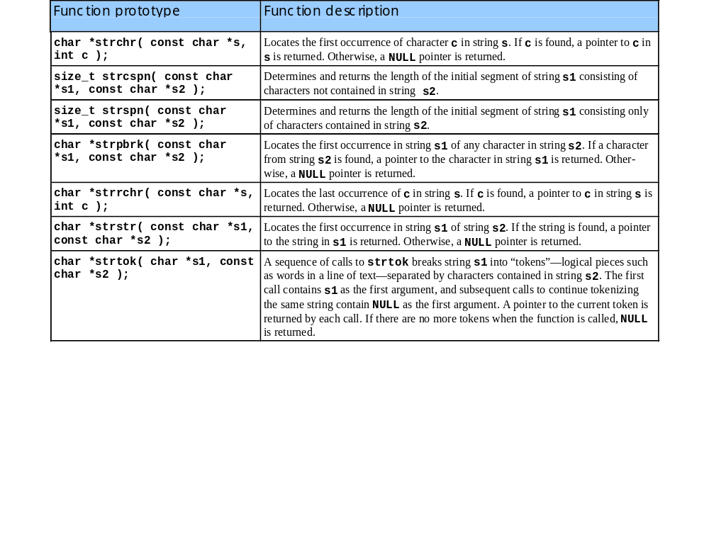
Search Functions of the String Handling Library

Slide 12

Other Functions of the String Handling Library
  char *strerror( int errornum );
  Creates a system-dependent error message based on errornum
  Returns a pointer to the string
  size_t strlen( const char *s );
  Returns the number of characters (before NULL) in string s
1 /* Fig. 8.37: fig08_37.c
2 Using strerror */
3 #include <stdio.h>
4 #include <string.h>
5
1. Function call
2. Print
Program Output
6 int main()
7 {
8 printf( "%s\n", strerror( 2 ) );
9 return 0;
10 }
No such file or directory

